Slide 1


BUILD A DATA SCIENTIST AI AGENT IN CREWAI

Slide 2



Project Overview
In this project, we’ll apply machine learning regression techniques to predict revenues generated from supplement sales based on various factors such as price, location, and discounts.
We will focus on understanding the workflow to build machine learning regression models in a typical data science project, to automate it using AI agents built in CrewAI.
Model Inputs
Date
Product Name
Category
Price
Discount
Location
Model Output
© All rights reserved for Dr. Ryan Ahmed @Stemplicity Inc.
Machine Learning Regression Model
Units Sold

Slide 3
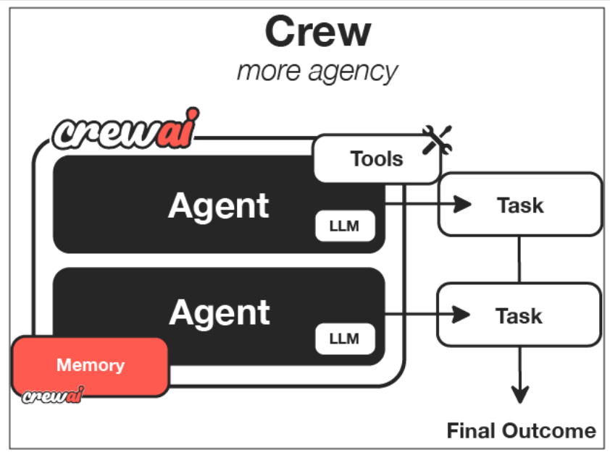
What is CrewAI?
CrewAI is an open-source Python framework designed to build and manage multi-agent AI systems.
It enables developers to create teams of AI agents named "crews”.
These crews collaborate to execute complex, multi-step tasks more efficiently than a single agent could manage alone. Each agent within a crew is assigned a specific role, goal, and set of tools, facilitating structured and autonomous workflows.​
Just like a company has departments (Sales, Engineering, Marketing) working together under leadership to achieve business goals, CrewAI helps you create an organization of AI agents with specialized roles collaborating to accomplish complex tasks.
© All rights reserved for Dr. Ryan Ahmed @Stemplicity Inc.
Documentation: https://docs.crewai.com/introduction

Slide 4

Key Learning Outcomes
Understand CrewAI core components: Agents, Tasks, Tools, and the Crew.
Create a custom tool that allows our agents to execute Python code (for data analysis and modeling).
Design specialized agents for: (1) Planning data science workflow, (2) Executing data analysis/preprocessing, (3) Building/evaluating models.
Review machine learning regression fundamentals & perform the entire workflow manually (without CrewAI)
Assemble a crew of AI Agents to perform the regression analysis on the supplement sales data.
Examine the results generated by the CrewAI agents, including the final analysis and the code produced & compare it to manual results.
© All rights reserved for Dr. Ryan Ahmed @Stemplicity Inc.

Slide 5
CrewAI Features
Role-Based Agents:
Assign distinct roles and responsibilities to each agent, such as researcher, writer, or planner, allowing for specialized task execution.​
Tool Integration:
Agents can utilize both built-in and custom tools, including APIs and web search functionalities, to perform their designated tasks effectively.​
Memory Management: Support for short-term, long-term, and shared memory enables agents to maintain context.​
Hierarchical Task Delegation: Implement manager-worker models where a supervisory agent delegates tasks to subordinate agents, optimizing workflow management.​
Observability and Monitoring:
Integrate with monitoring tools to track agent performance, task execution, and system scalability in real-time.
Autonomous Collaboration: Agents operate independently yet coordinate with one another to complete tasks, enhancing scalability.​
© All rights reserved for Dr. Ryan Ahmed @Stemplicity Inc.

Slide 6

Summary
We leveraged CrewAI to assemble a team of intelligent agents, each responsible for a specific step in the data science pipeline (data preprocessing, model training, evaluation, and reporting).
Tasks were clearly defined and assigned to the most appropriate agents, enabling a streamlined, modular execution of the machine learning workflow.
The agent-based system promotes scalability and reusability, making it easy to replicate the process across multiple datasets or projects.
CrewAI agents don’t replace data scientists; they work with them. By automating repetitive and time-consuming tasks, agents free up human experts to focus on high-impact decision-making, accelerating productivity and innovation.
© All rights reserved for Dr. Ryan Ahmed @Stemplicity Inc.

Slide 7
Thank you!

